Slide 1
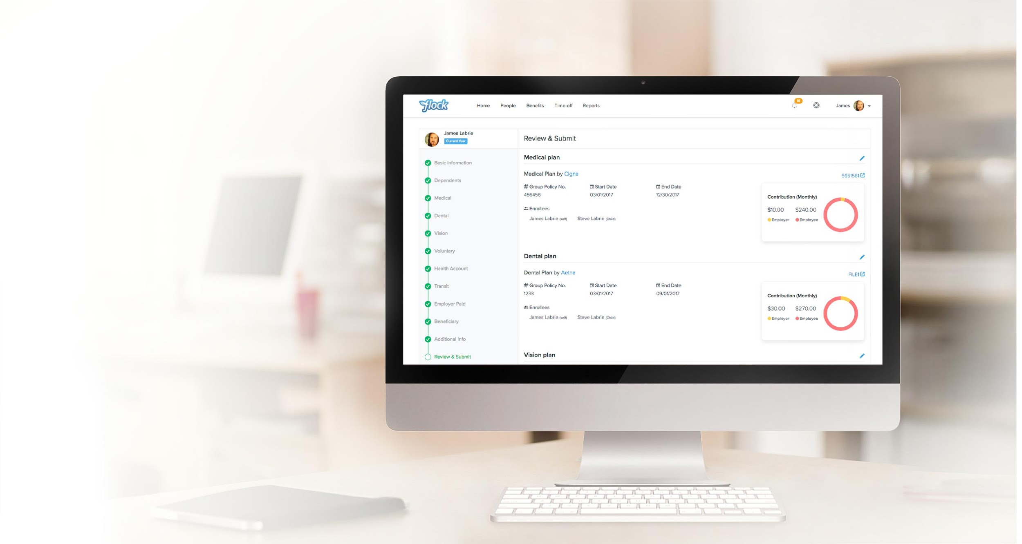
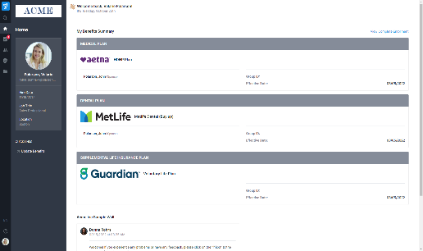
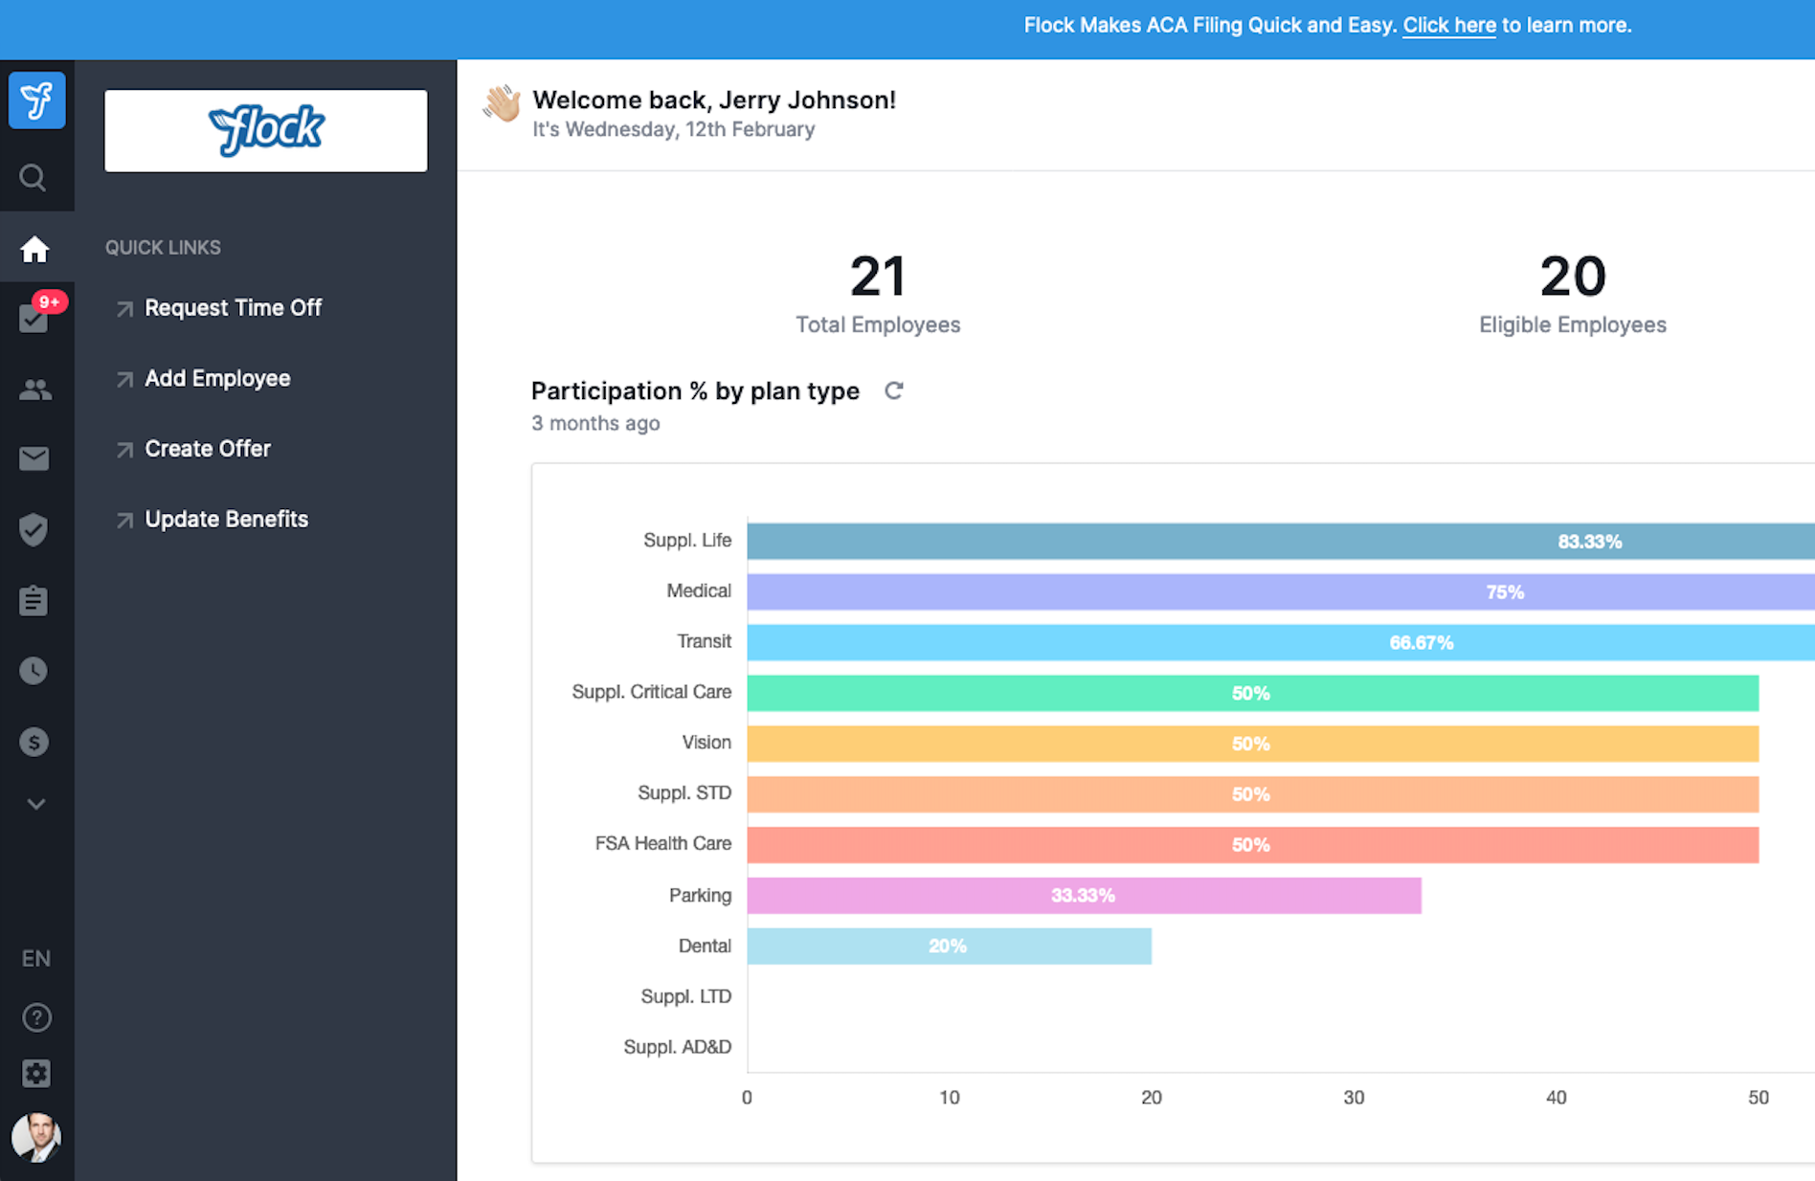

Flock Benefits Administration, by Paychex
Employee quick start guide
Benefits Enrollment

Slide 2
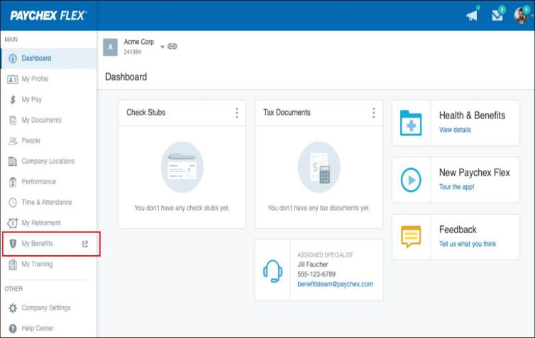
1. Access My Benefits in Paychex Flex®
Once you log into Paychex Flex, click My Benefits, which will open the Flock platform.

Slide 3
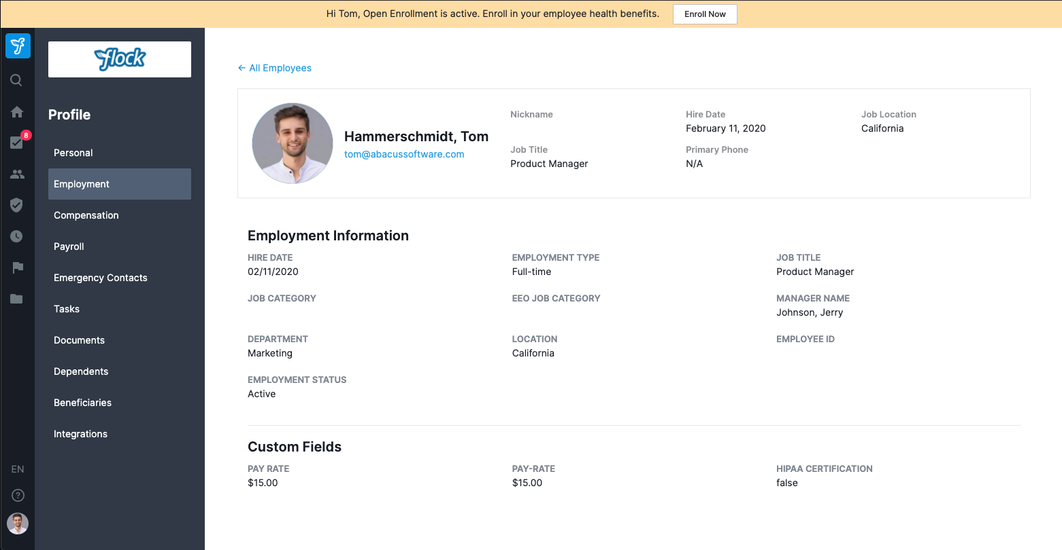
2. Review Profile
Make any updates in Flex or discuss with your company contact if anything is incorrect.
Note: Your profile is private and only visible to you, your manager, and your administrator.

Slide 4
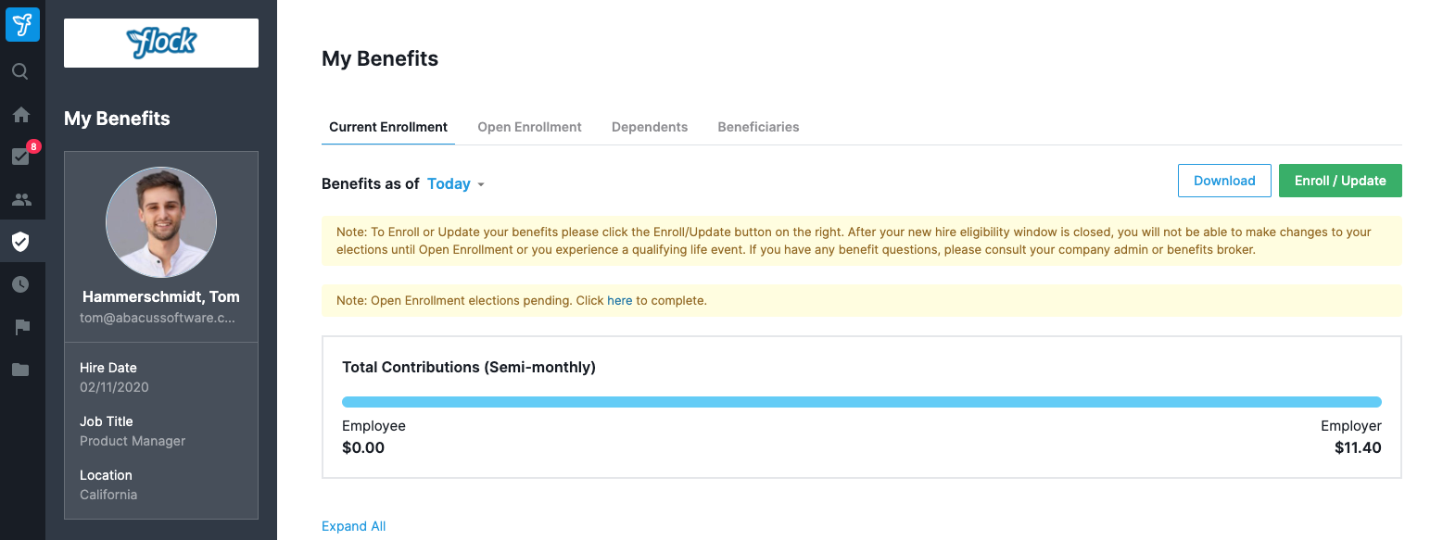
3. Enroll in Benefits
Enter the Benefits Enrollment flow
If you are eligible to enroll, click the Benefits icon in the left-hand navigation menu. Then, click the Enroll/Update button.

Slide 5
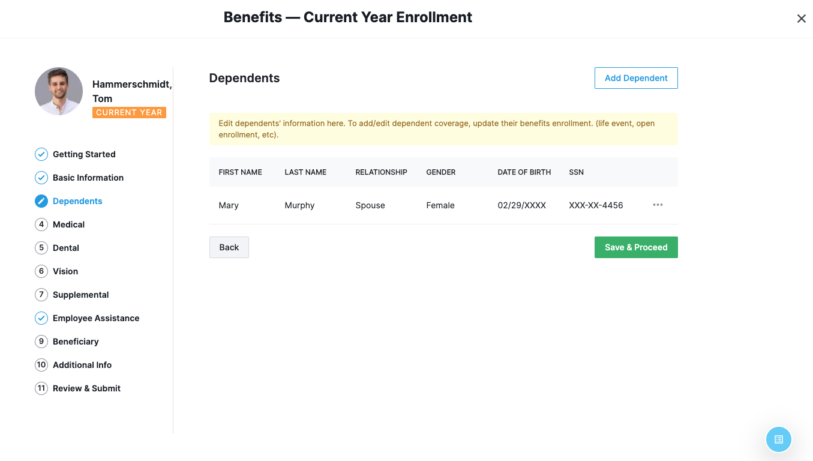
3. Enroll in Benefits: Add Dependents
View, change or add dependents
This step lets you add and verify dependents at the time of enrollment, so you can also select and add them to plans in the next steps.

Slide 6
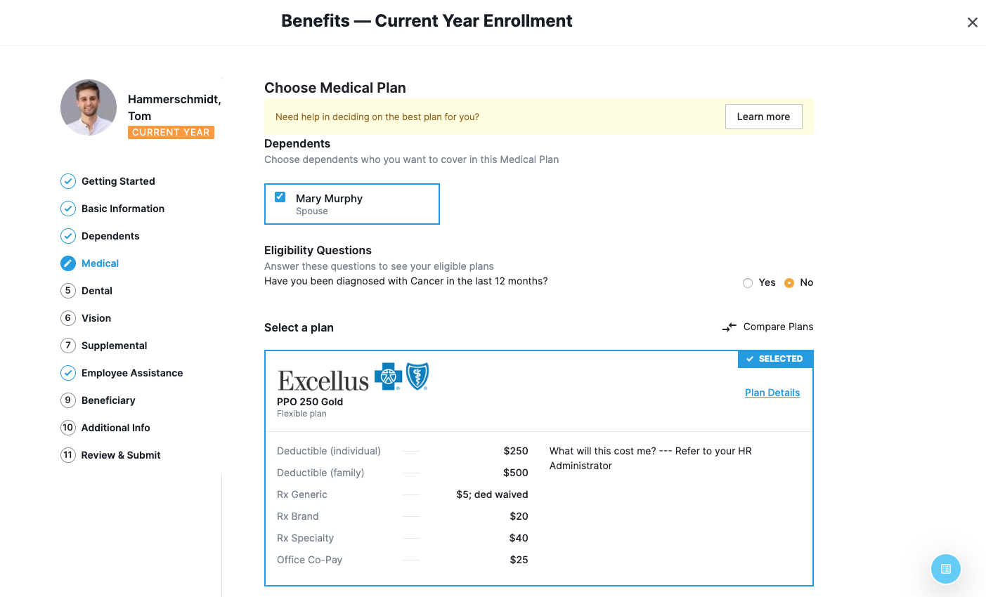
3. Enroll in Benefits: Enroll Dependents
Remember to enroll your dependents
To enroll your dependents on a plan, select them at the top of the page.
Then, select the plan that best suits your needs.

Slide 7
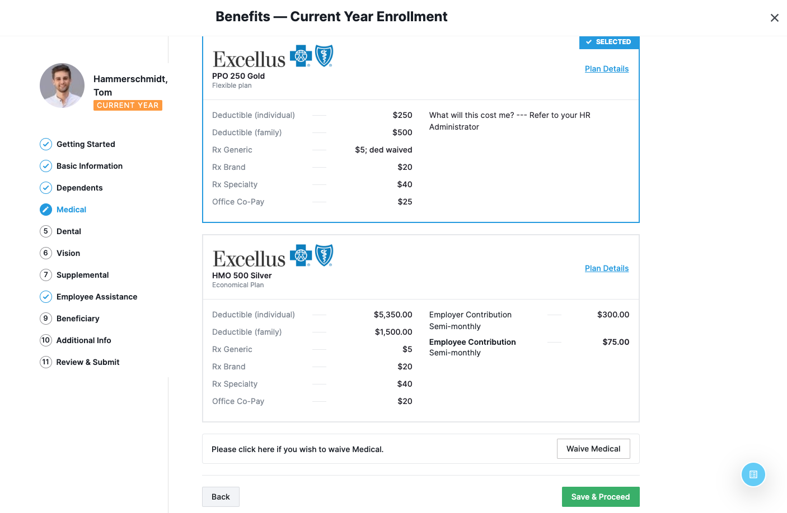
3. Enroll in Benefits: Select a Plan
View or change
your benefits in the Benefits tab
To make your elections, select the plan card that is the best fit for your needs.
For more plan info, click Plan Details.

Slide 8
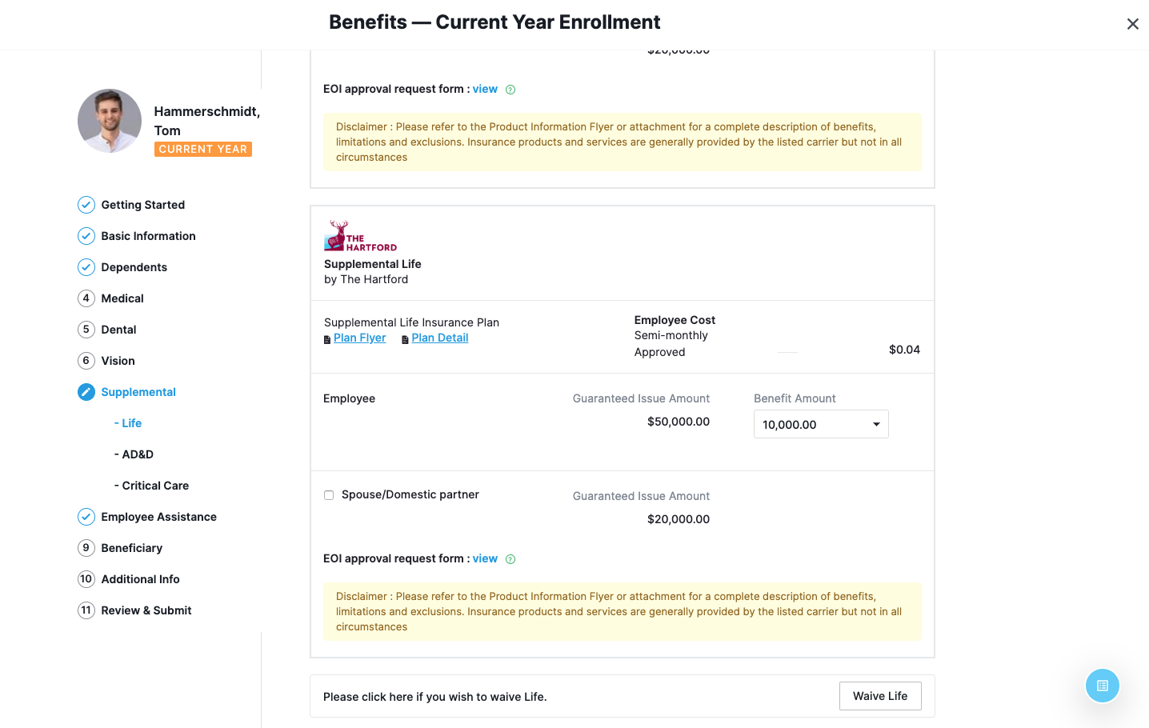
3. Enroll in Benefits: Continue Enrollment
Select Additional Benefits
Continue through the enrollment flow and either select or waive each benefit.

Slide 9
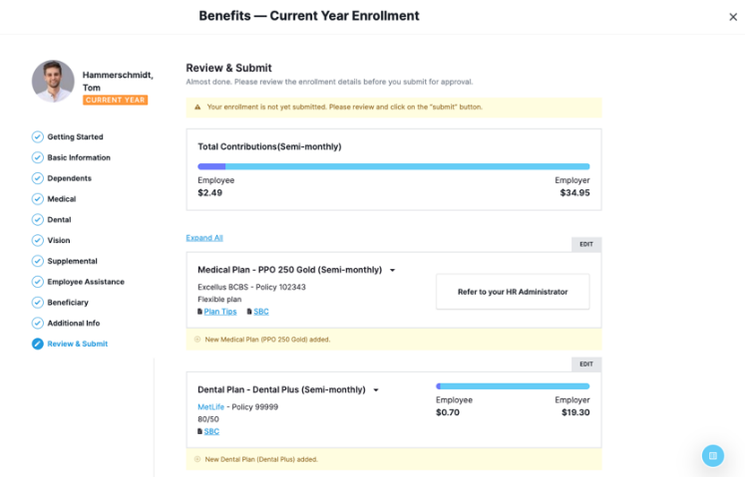
3. Enroll in Benefits: Submit Enrollment
Remember to click the final Submit Enrollment button to record your benefit elections.
You can view your elections and plan documents at any time
on the Benefit Summary page.

Slide 10
Congratulations on completing your enrollment!

